Slide 1
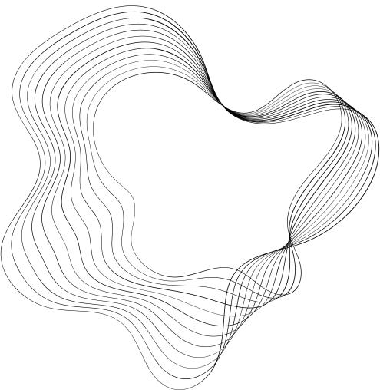

HEART
ATTACK
PREDICTION

Slide 2
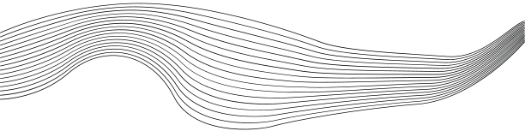
CONTENT
01
PROBLEM STATEMENT
02
PROPOSED METHODOLOGY
03
RESULTS
04
RELATED WORK
05
OUR TEAM

Slide 3

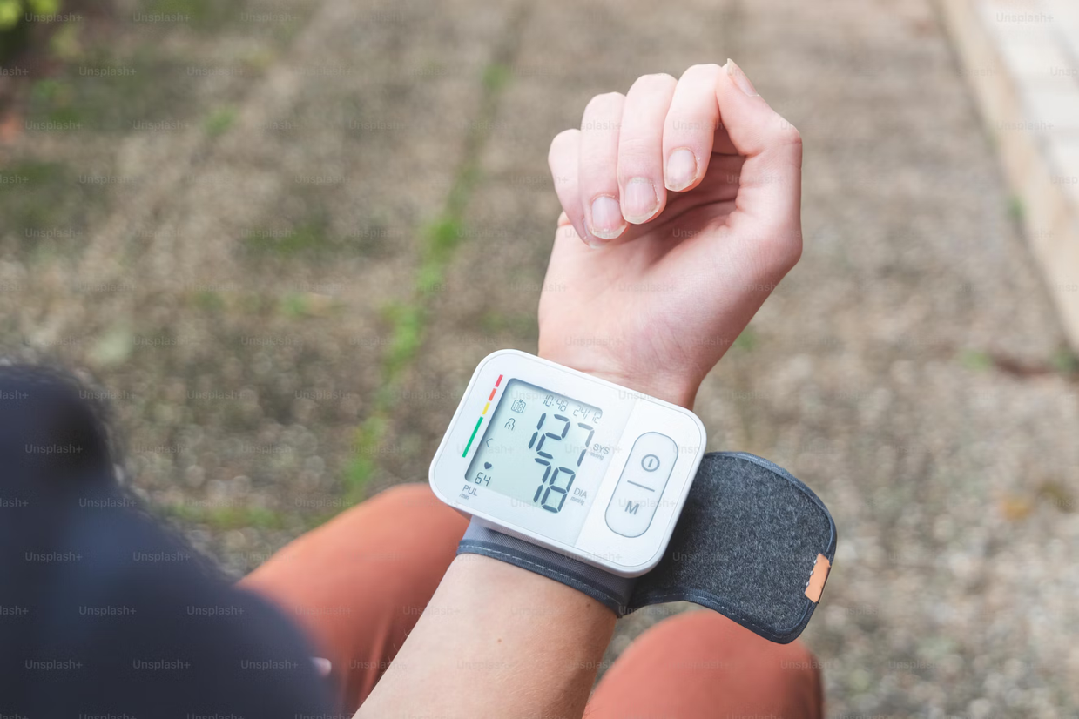

INTRODUCTION
Heart Attack is a major global issue, and early detection is key, Doctors use ECGs to monitor heart activity, but analyzing them can be time consuming, and subtle signs may be missed, AI helps improve the speed and accuracy of ECG analysis. CNNs, known for recognizing patterns, can be trained to spot key features in ECG images. Using transfer learning with ResNet50, we fine-tuned a model to classify heart conditions

Slide 4


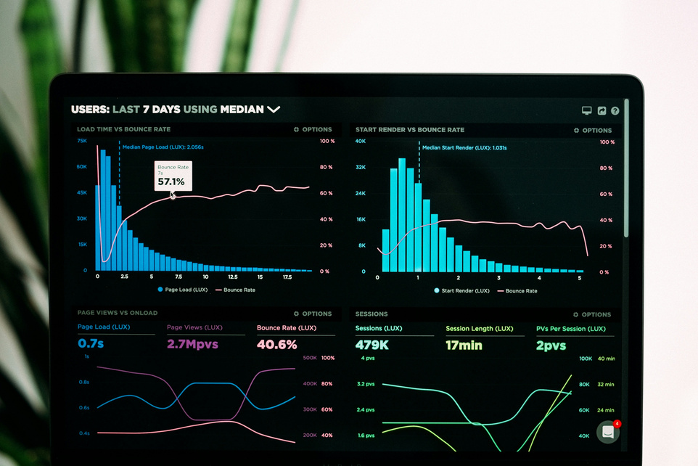
PROPOSED METHODOLOGY
With limited data, training a model from scratch can be challenging. Transfer learning leverages pre-trained models, enabling us to fine-tune on specific tasks, which improves performance and reduces training time. This approach helps utilize learned features from large datasets, making it ideal
for medical image classification, especially when data is scarce.
ResNet50 is a deep Convolutional Neural Network (CNN) with 50 layers.
It solves the problem of "vanishing gradients" in very deep networks.
Introduced the concept of Residual Learning.
Widely used in image classification tasks

Slide 5
RESNET-50
Total Convolutional Layers3*3: 33
Total Convolutional Layers1*1: 17
Total Max Pooling Layers: 1
Total Average Pooling Layers: 1
Fully Connected Layers: 1 with 1000
neurons takes an image of size 224x224

Slide 6

DATA
The dataset has 4 classes:
normal heart beats
abnormal heart beats
experiencing a heart attack
had a heart attack Each class
has approximately 200-250 images for training.
Dataset link: https://data.mendeley.com/datasets/gwbz3fsgp8/2

Slide 7
RESULTS
The model trained for 6 epochs with 98% accuracy (Cuda configuration powered by INVIDIA was used.
Early Stopping was used to save the best weights of the model and prevent overfitting.
98%

Slide 8
RELATED WORKS
A CNN and ResNet 50 Approach to Detect Cardiac Diseases using ECG Images
Application of Deep Learning for Heart Attack Prediction with Explainable Artificial Intelligence

Slide 9
OUR TEAM
ziad hany
youssef shedied
rania mamdouh
ahmed eid
ahmed emad

